Slide 1
NATIONAL POSTAL POLICY
PRESENTED BY GROUP NO. 8

Slide 2
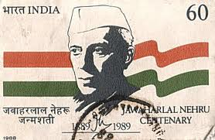
GROUP MEMBERS
Ms. Reena Nagar (Group Co-ordinator)
Sri Kote Sandip Ravindra
Sri Mirza Azhar Beig
Sri Salunkhe Shivkumar Popat
Sri Sushant Sudan
Ms. Divya S. Iyer
Sri Vamsidhar T.V.
Sri A. Sridhar
Sri Mahaling
Sri Prasant Gawande

Slide 3
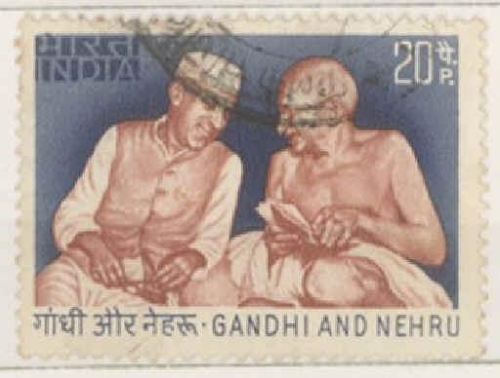
OBJECTIVES
Developing an organised and well
governed postal sector.
Augmenting access to postal services.
Enhancing the quality of service.
Developing postal and supporting infrastructure.
Promoting the use of ICT in provisioning of postal services.
Promoting utilisation of postal services to deliver national programmes and e-services.

Slide 4
OBJECTIVES
Developing a framework for Human Resource Development and planning.
Promoting competition in the provision of postal services.
Develop an institutional and governance framework.
Strengthen the National Postal Administration.

Slide 5
Public good
More accessibility (primary public access point).
Environment friendly (reduced carbon foot print).
Spread of postal infrastructure in rural area.
Small and medium postal operators will be supported by government to provide quality services.

Slide 6
Continued…..
More value added products and services.
Basic postal services at affordable prices.
Help the nation to achieve MDGs.

Slide 7
STAKEHOLDERS
CITIZENS
GOVERNMENTS
BUSINESSES

Slide 8
SERVICES
MAIL SERVICES | FINANCIAL SERVICES | EXPRESS PARCEL
LETTERS, POST CARDS | POSTAL SAVING BANK | E-COMMERCE-RETAILING
 | PENSIONS /SOCIAL SECURITY | MEDIA POST
 | LIFE INSURANCE | EXPRESS POST
 | REMITTANCE
 | SINGLE WINDOW SERVICES | LOGISTIC POST

Slide 10
ENHANCEMENTS
Making transformation of post offices in to the PRIMARY PUBLIC ACCESS POINTS (PPAP).
Redesigning the business structure (autonomy and digitization).
Amendment of Indian Post Office Act according to new requirements.
Financial services and e-commerce services.
Standardization of processes and products.
Adoption of global practices.

Slide 11
NEW INITIATIVES
Postal advisory council
Postal development board
Post bank of India
Carbon footprint preparedness
Promotion of use of ICT
Scaling up the traditional business coverage

Slide 12
FINANCIAL STRENGTHENING
Launching the Special Purpose Vehicle (SPV) and Joint Ventures
Promotion of PPP model
For attract investment Making Fiscal Management stable
Try to attract investment (international and domestic)

Slide 13
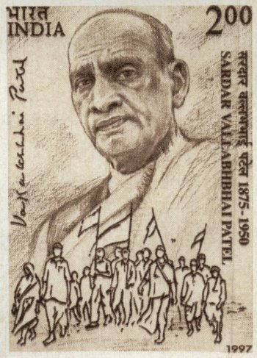
Reservations about the Draft Policy
Takes an overly simplistic view of the postal sector
Ignores proposals already floated by the Department of Posts
Does not take account of the existing ICT initiatives and Postal Research Work
Potential negative impact of the theory of level playing field

Slide 14
International perspective
Comparison with Australia’s Policy:
Australia Post is committed to promoting equality of opportunity and eliminating discrimination in its employment policies and practices.
Australia Post takes care in selecting suppliers of goods and services and expects them to operate to recognised national and/or international standards and appropriate codes of practice.
Australia Post's Refund Policy, that includes how to seek an exchange, repair or refund of Australia Post purchased products.
Engaging with the local community: when planning changes to the retail network, and how the community and key stakeholders can participate in the retail change planning process.
Work Ready Program facilitates best practise injury management principles for all Australia Post employees.

Slide 15
Comparison with Canada’s Policy:
Canada Post's policy to manage the on going reduction of environmental risks and issues associated with Asbestos, Polychlorinated biphenyl (PCB's storage and disposal),Fuel storage tanks management, Ozone-depleting substances, Occupation of lands and buildings containing regulated substances, Acquisition and disposal of lands and buildings, Toxic substances and hazardous waste, Waste Management, Vehicles fuel consumption and idling time

Slide 16
Purchasing Philosophy, Buying Practices, Sourcing Suppliers, Tender Opening, Issuance of Contract are missing in India's postal policy compared to Canada’s.
Comparison with China :
More valued added services like circulation of news papers, journals and books, Self Designed Greeting, Flight Ticket Bookings, Hotel Reservations.
Ule.com.cn, produced by China Post and the TOM Cooperation, is a unique new shopping platform.

Slide 17
UPU
The Universal Postal Union is a specialized agency of the United Nations that coordinates postal policies among member nations, in addition to the worldwide postal system. The UPU contains four bodies consisting of the Congress, the Council of Administration (CA), the Postal Operations Council (POC) and the International Bureau (IB).

Slide 18
Implementation Issues
Heavy Protests regarding implementation from National Federation of Postal Employees (NFPE), All India Postal Employees Union (AIPEU) & allied unions
Amendment to the Indian Post office Act 1898; 2006 Indian Post office Act Amendment bill
Standing Committee Report clearly recommended that the exclusive privilege of collection, processing, conveyance and delivery of letter mail articles should remain with the Postal itself.

Slide 19
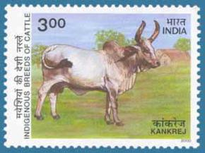
Implementation Issues
Issues relating to Standardization of mail and National Address System
Unfeasible pre-requisites like modern transportation network to support countrywide conveyance & transportation of mail
Too much “funds” and “investments” to be amassed

Slide 20
ALTERNATIVE POLICY RECOMMENDATION
Strengthen Grievance Redressal Mechanisms
Employee Welfare Measures to be enhanced
An intact system to ensure Postal Security/ Cyber Security
Diversification of activities need to be accompanied by decentralization of power; Hub & Spoke model to be adopted
Utilize the reach of Postal network to spread awareness amongst the masses
Penetrate into the corporate web and leverage upon the corporate benefits
Manpower to be utilized for varied activities like Surveys
Commercial value of philately to be exploited

Slide 21
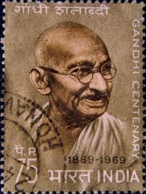
Be like a postage stamp Stick to one thing until you get there Josh Billings

Slide 22
THANK YOU!!!
FOR YOUR PATIENCE……

